Slide 1
Energy and Water Budgets
September 17, 2019

Slide 2
Pre-class ice breaker → write down your answer
Are urban areas cooler than close-by rural areas? Why or why not?
Why are polar areas warming at a faster rate than equatorial areas?
Why are greenhouse gases warming the Earth?

Slide 3
The surface energy budget

Slide 4
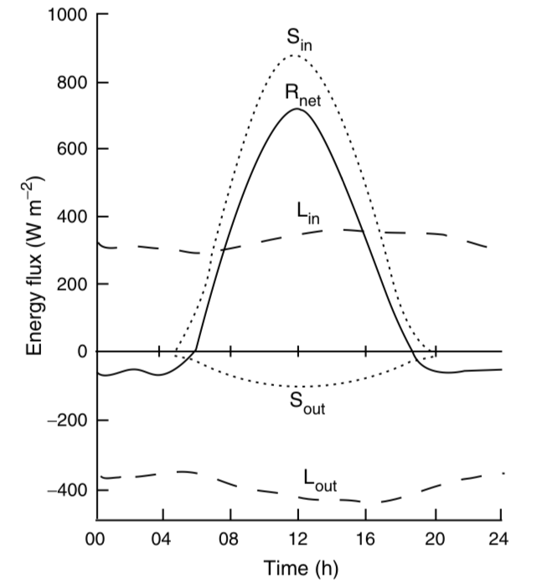
The net radiation absorbed by a surface is a sum of ingoing and outgoing radiation
K
K

Slide 5
The net radiation absorbed by a surface is a sum of ingoing and outgoing radiation
K
R_{net} = (K_{in} – K_{out}) + (L_{in} – L_{out})
K

Slide 6
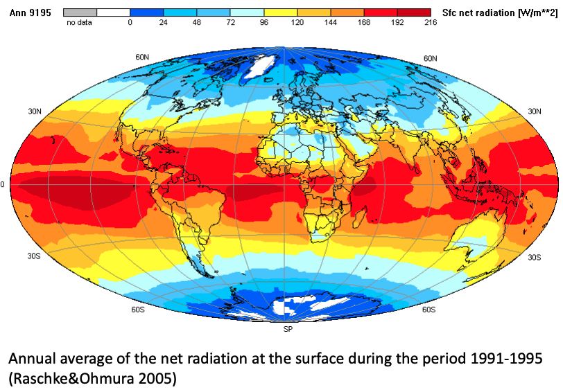
R_{net}

Slide 7
Shortwave (K) depends on the albedo (α)
K
R_{net} = (K_{in} – K_{out}) + (L_{in} – L_{out})
R_{net} = (1– α)K_{in} + (L_{in} – L_{out})
K

Slide 8
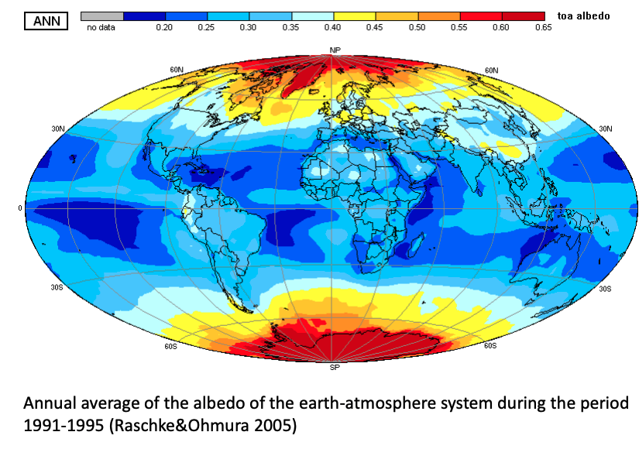
α

Slide 9
Longwave (L) depends on temperature (T)
K
R_{net} = (K_{in} – K_{out}) + (L_{in} – L_{out})
R_{net} = (1– α)K_{in} + (L_{in} – L_{out})
R_{net} = (1– α)K_{in} + (L_{in} – L_{out})
L_{in} = σε_{sky}T_{sky}⁴
L_{out} = σε_{surface}T_{surface}⁴
ε = emissivity
σ = Stefan-Boltzman constant
K

Slide 10
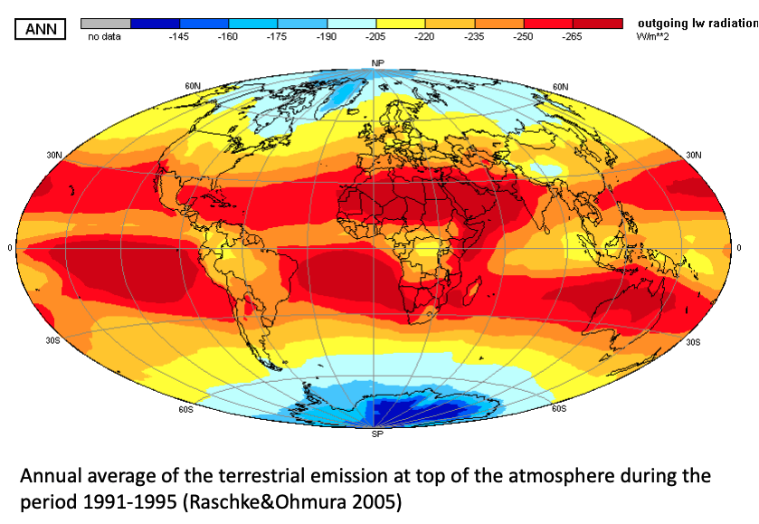
L_{out}

Slide 11
Net radiation (R_{net}) is partitioned into different fluxes at the surface
R_{net} = H + LE + G + ∆S

Slide 12
Net radiation (R_{net}) is partitioned into different fluxes at the surface
R_{net} = H + LE + G + ∆S
Total radiation absorbed by the surface

Slide 13
Net radiation (R_{net}) is partitioned into different fluxes at the surface
R_{net} = H + LE + G + ∆S
Sensible heat flux (heat transfer without phase change)

Slide 14
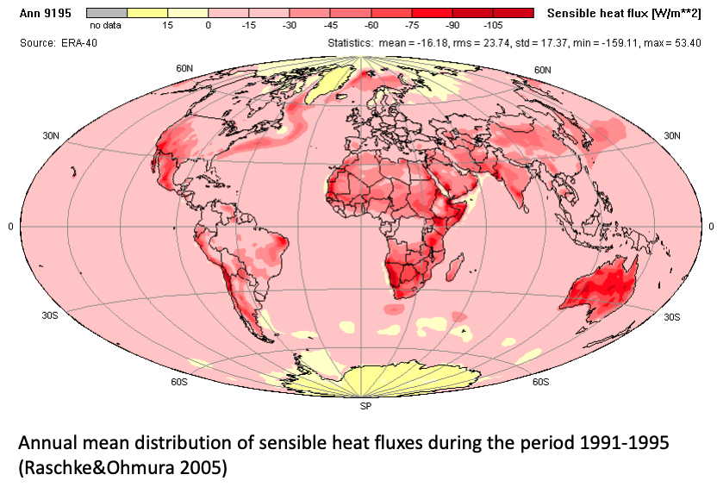
H

Slide 15
Net radiation (R_{net}) is partitioned into different fluxes at the surface
R_{net} = H + LE + G + ∆S
Latent heat flux (heat transfer with phase change)
L = latent heat of vaporization (constant)
E = evapotranspiration

Slide 16
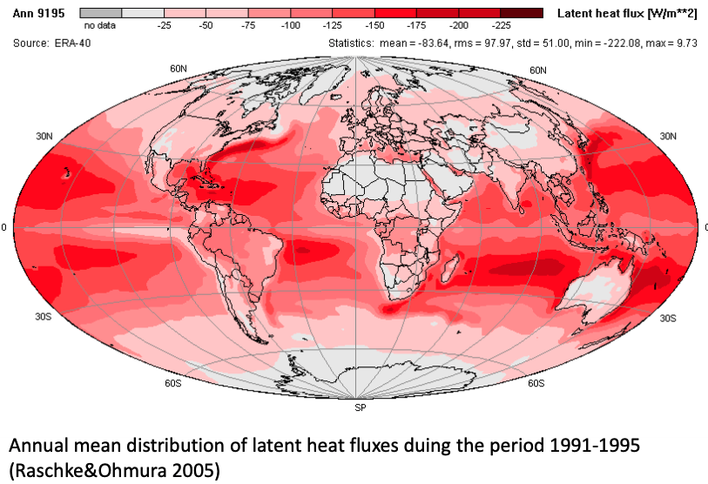
LE

Slide 17
Net radiation (R_{net}) is partitioned into different fluxes at the surface
R_{net} = H + LE + G + ∆S
Ground heat flux (small flux of energy from soils)

Slide 18
Net radiation (R_{net}) is partitioned into different fluxes at the surface
R_{net} = H + LE + G + ∆S
Storage

Slide 19
Now that we have R_{net} in two equations, we can build a full energy budget equation

Slide 20
Class activity → turn in for participation point
Solve the surface energy budget for T_{surface}
Answer the beginning of class questions using your equation:
Are urban areas cooler than close-by rural areas? Why or why not?
Why are polar areas warming at a faster rate than equatorial areas?
Why are greenhouse gases warming the Earth?

Slide 21
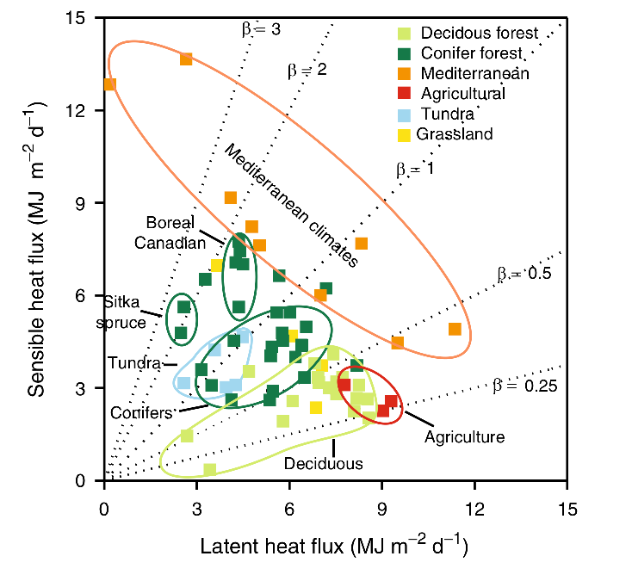
Bowen ratio – ratio of sensible to latent heat flux
Low transpiration/ Dry ecosystems
High transpiration/Wet ecosystems

Slide 22
Bowen ratio – is spatially and temporally variable
Desert - High
Spatial – turbulence within and between ecosystems
Temporal – snowmelt, bud break
Tropical Rainforest – Low
Tight linkage of energy and water budgets

Slide 23
Surface energy budget recap
Important biological characteristics
Albedo
Transpiration (latent heat flux)
Coupling with terrestrial water cycles
Influences atmospheric water demand
Influences atmospheric water storage

Slide 24
Surface energy budget recap
Important biological characteristics
Albedo
Transpiration (latent heat flux)
Coupling with terrestrial water cycles
Influences atmospheric water demand
Influences atmospheric water storage

Slide 25
Higher photosynthesis
Smith et al. (2017)

Slide 26
Higher photosynthesis
More latent heat flux
Smith et al. (2017)

Slide 27
More latent heat flux
Local cooling
Smith et al. (2017)

Slide 28
Water budget

Slide 29
Questions
How does water enter a terrestrial ecosystem?
Where does it go?
Outputs
Storage

Slide 30
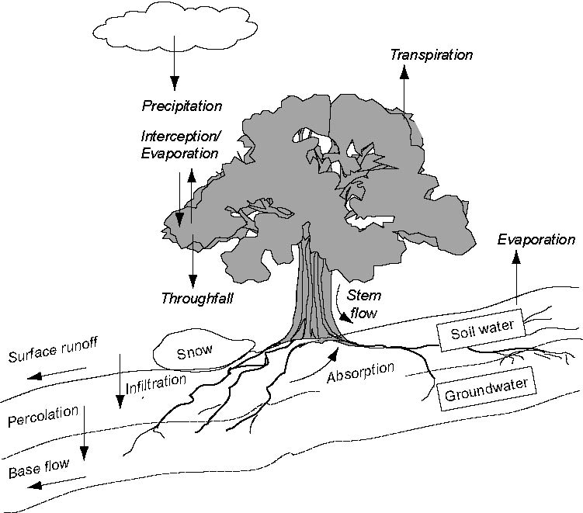

Slide 31
The Water Budget Precipitation +/- Storage = Evapotranspiration + Runoff

Slide 32
Water moves through ecosystems via potential gradients

Slide 33
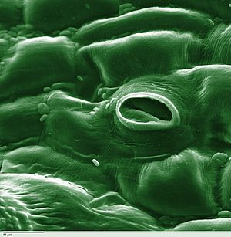
Water moves from high water potential to low water potential via a continuous water column/film

Slide 34
Remember: soil water potential depends on soil texture

Slide 35
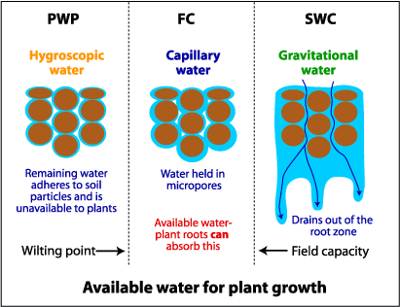

Slide 36
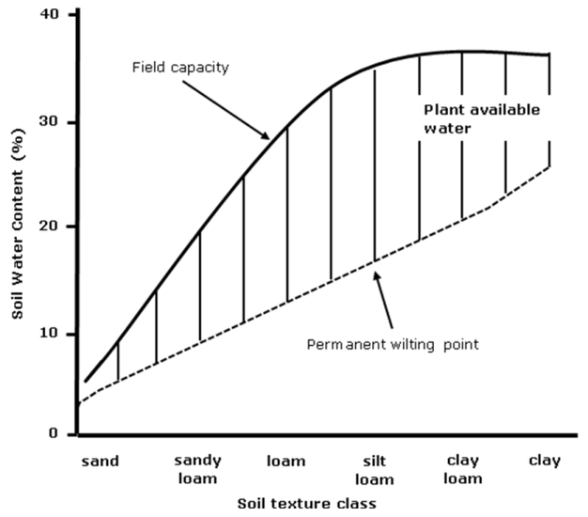

Slide 37
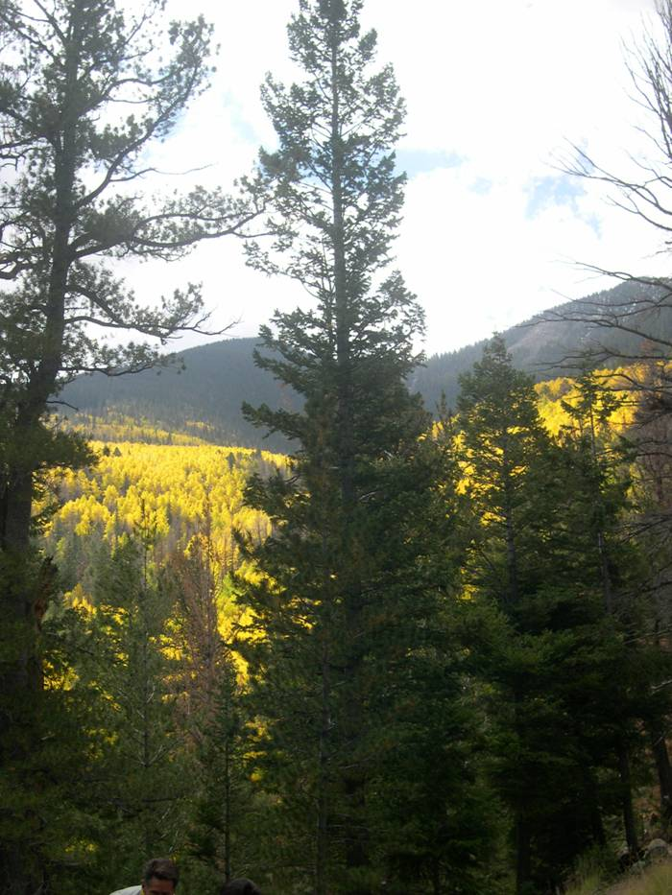
Transpiration is positively related to soil water availability…
(Fischer et al. 2003 Tree Phys.)

Slide 38
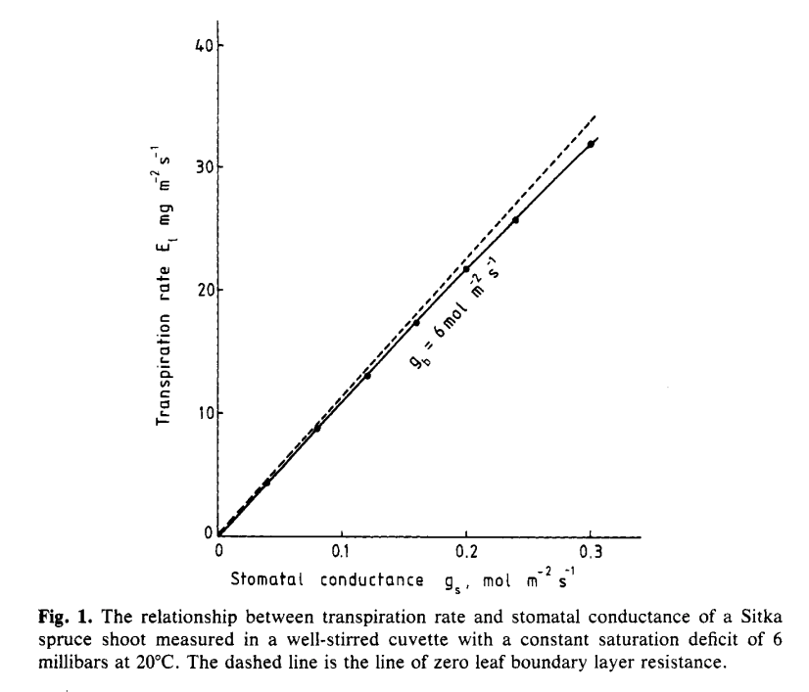
…and stomatal opening
Jarvis and McNaughton (1986)

Slide 39
How does transpiration respond to…
Higher temperatures?
Reduced humidity?
Higher light?
Higher CO₂?

Slide 40
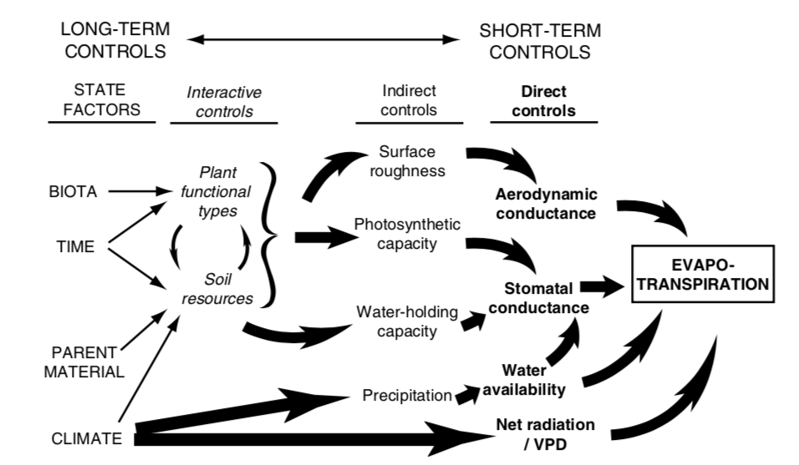

Slide 41
Side bar: Why are there more clouds over the vegetation?

Slide 42
Plant water movement varies by ecosystem due to differential species responses: Isohydry

Slide 43
Isohydry
Isohydric species are sensitive to changes in water availability, quickly closing their stomata in response to drought
Drought avoiders
Maintain high Ψ
Anisohydric species tend to respond more slowly to drought
Drought tolerators
Tolerate low Ψ

Slide 44
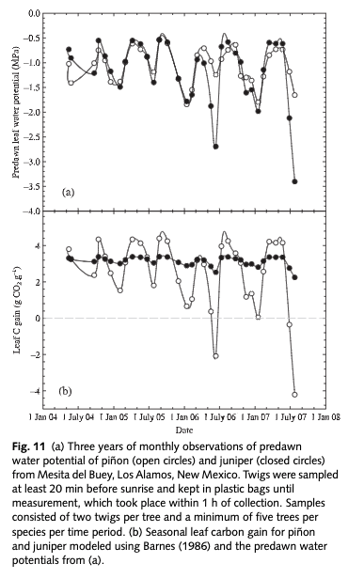
McDowell et al. (2008)

Slide 45
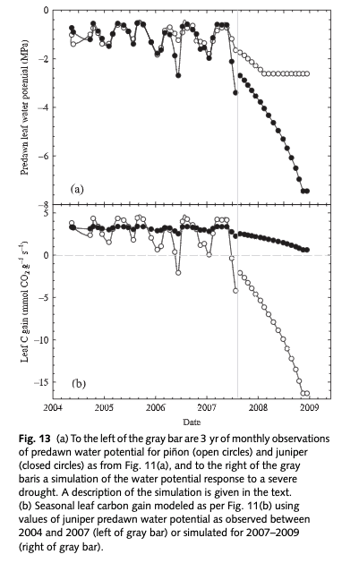
McDowell et al. (2008)

Slide 46
How would isohydry strategy influence the water cycle?

Slide 47
The Water Budget Precipitation +/- Storage = Evapotranspiration + Runoff

Slide 48
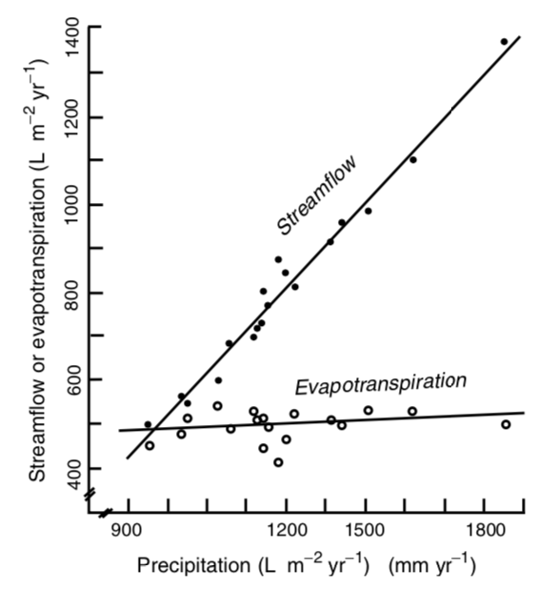
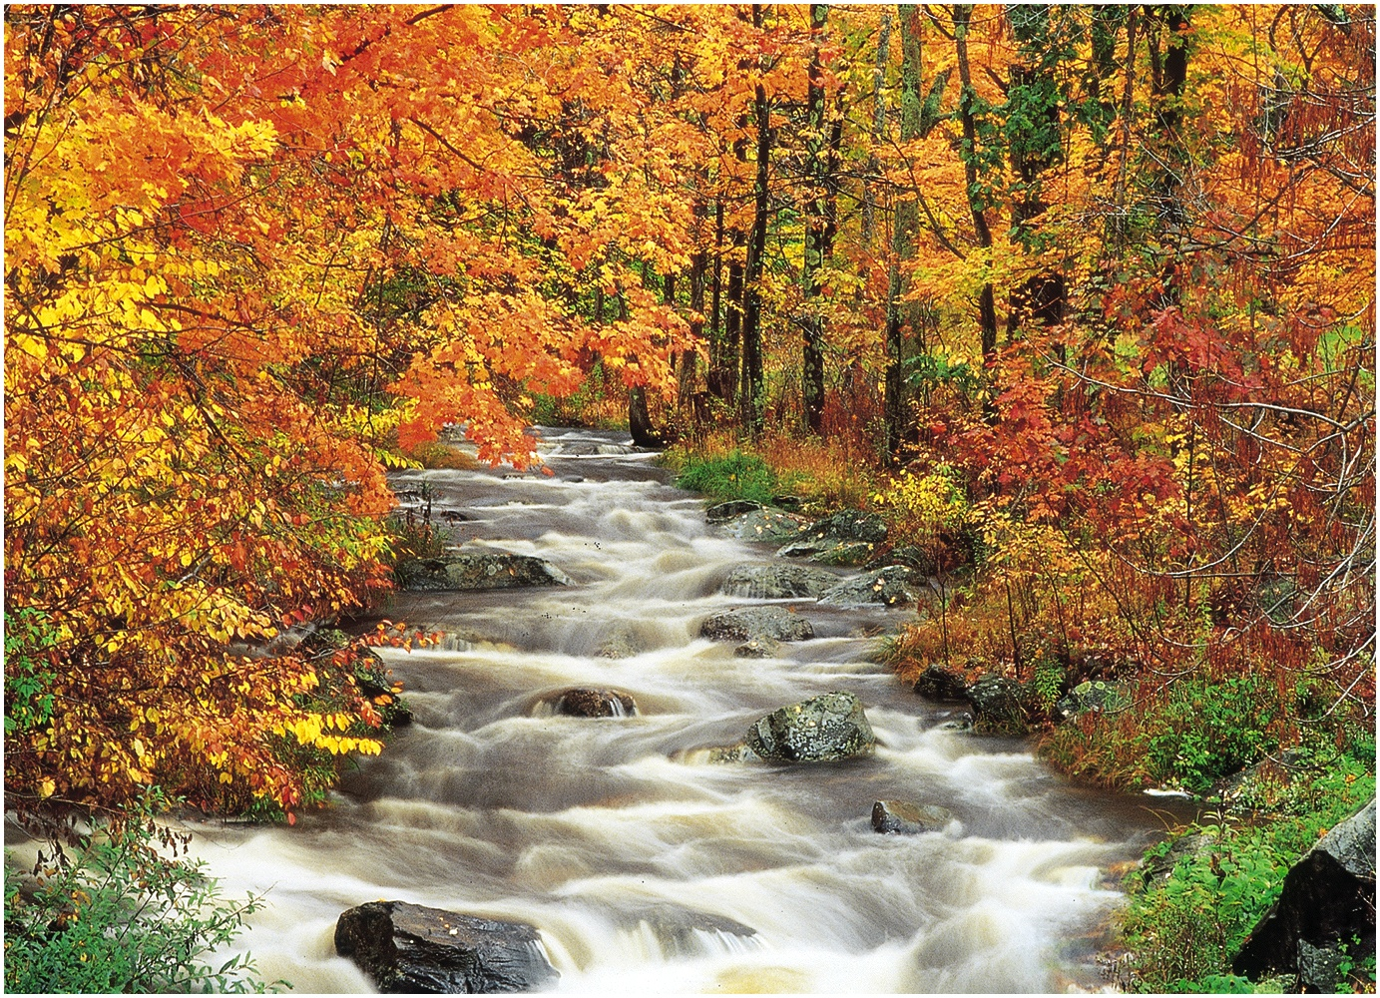
P + ∆S = E + R
P = Precipitation
S = Storage
E = Evapotranspiration
R = Runoff (streamflow)

Slide 49
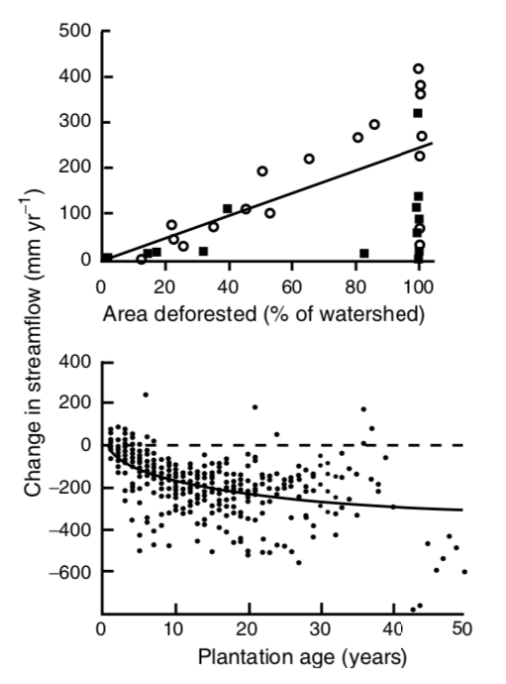
What’s happening here?

Slide 50
Final question: how are Energy and Water balances connected?

